Slide 1
GOOD FAITH EFFORT
CELEBRATION DAY FOR THOSE THAT GIVE GOOD EFFORT ON TESTING

Slide 2
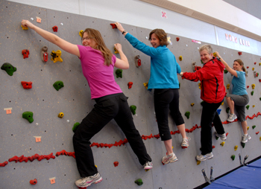
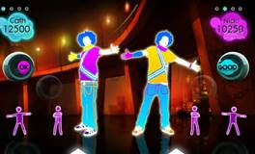
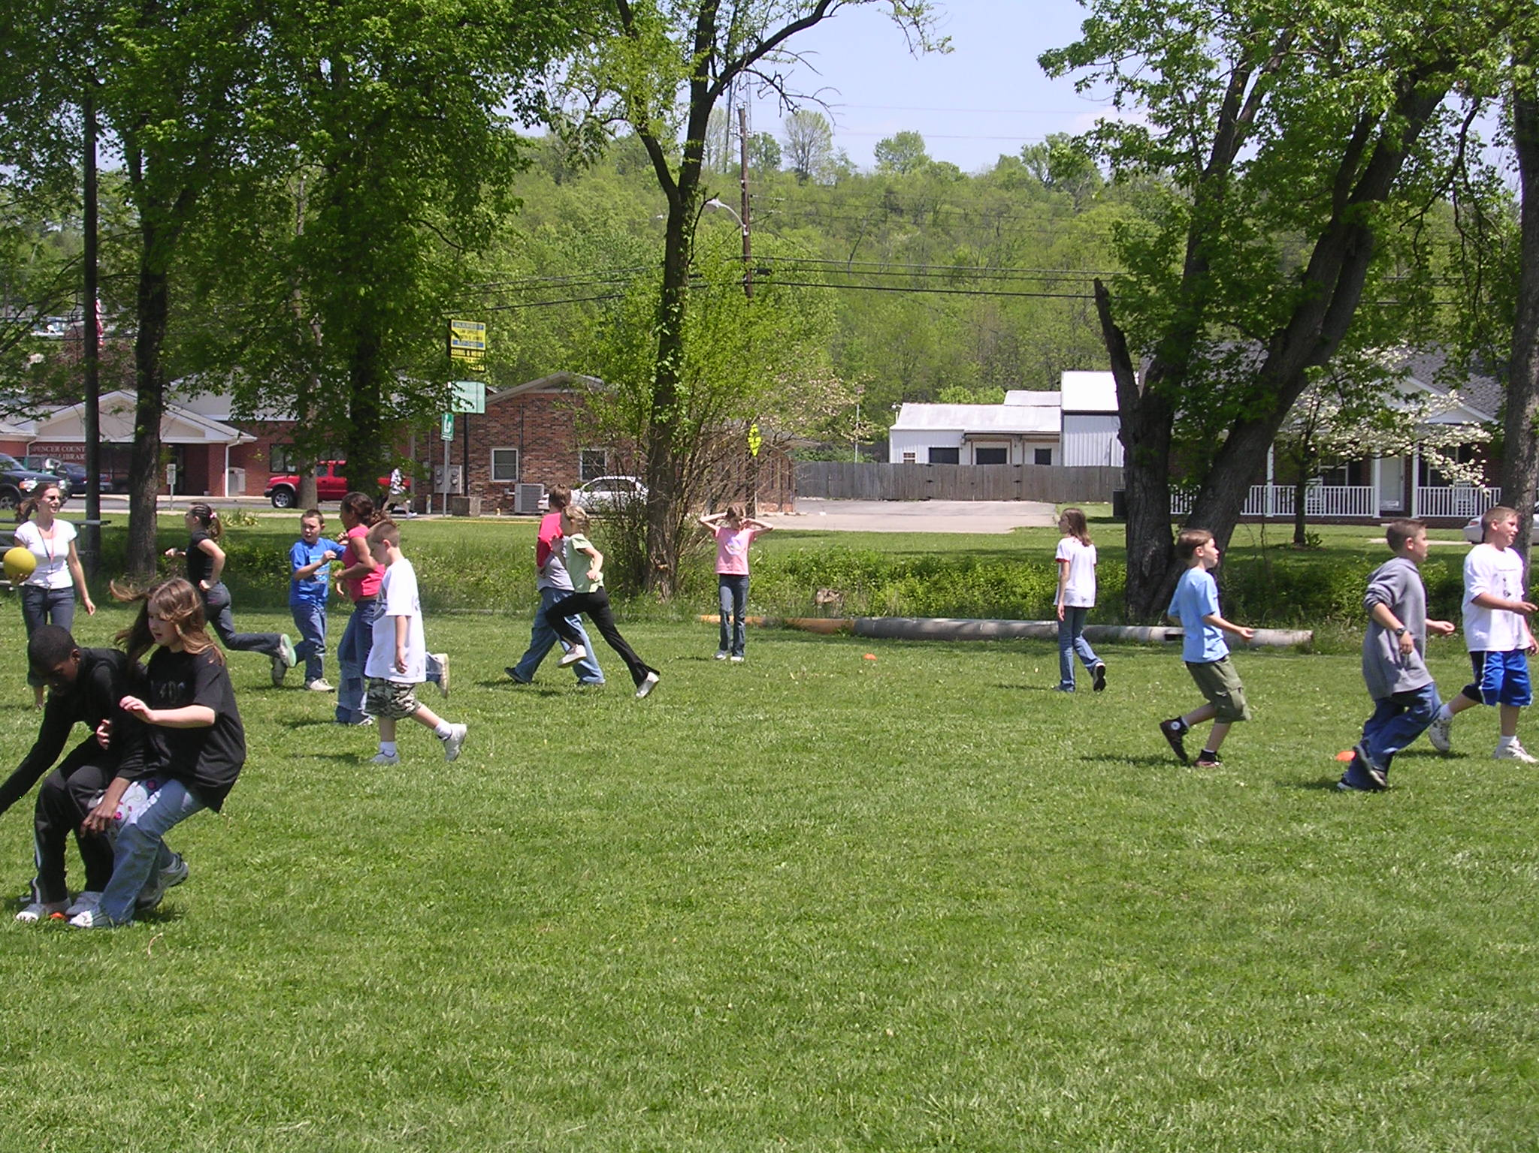
FUN EVENTS THAT DAY!
Rock wall time
Karaoke
wII gaming system in library – just dance!
Free play time outside
Movie time in classroom

Slide 3
Earn v.i.p. status PERFECT ATTENDANCE and good faith effort FOR TESTING WEEK!!!
v.i.p. status for the fun events :
entered into homeroom drawing to be the first in line at each fun event
Filled pawsitive card
Icy pop
Homeroom teachers may choose additional incentives

Slide 4
SO EASY TO EARN!!!
Use testing strategies
So so so important –
but still easy to do!

Slide 5
Strategies you should use
Use organizational strategy for your writing!!!!
Underlining words -power verbs in question – answers in the passage
Circling numbers -numbers in the words problems
Crossing out unnecessary information in word problem
Restating the question can help you focus your answer
Eliminate incorrect answers to narrow it down

Slide 6
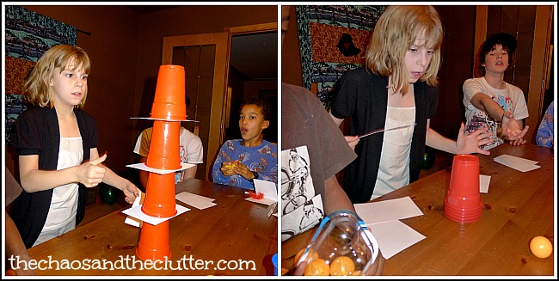
SCHOOL OF DISTINCTION
MINUTE TO WIN IT RACES IF WE EARN SCHOOL OF DISTINCTION AGAIN

