Slide 1
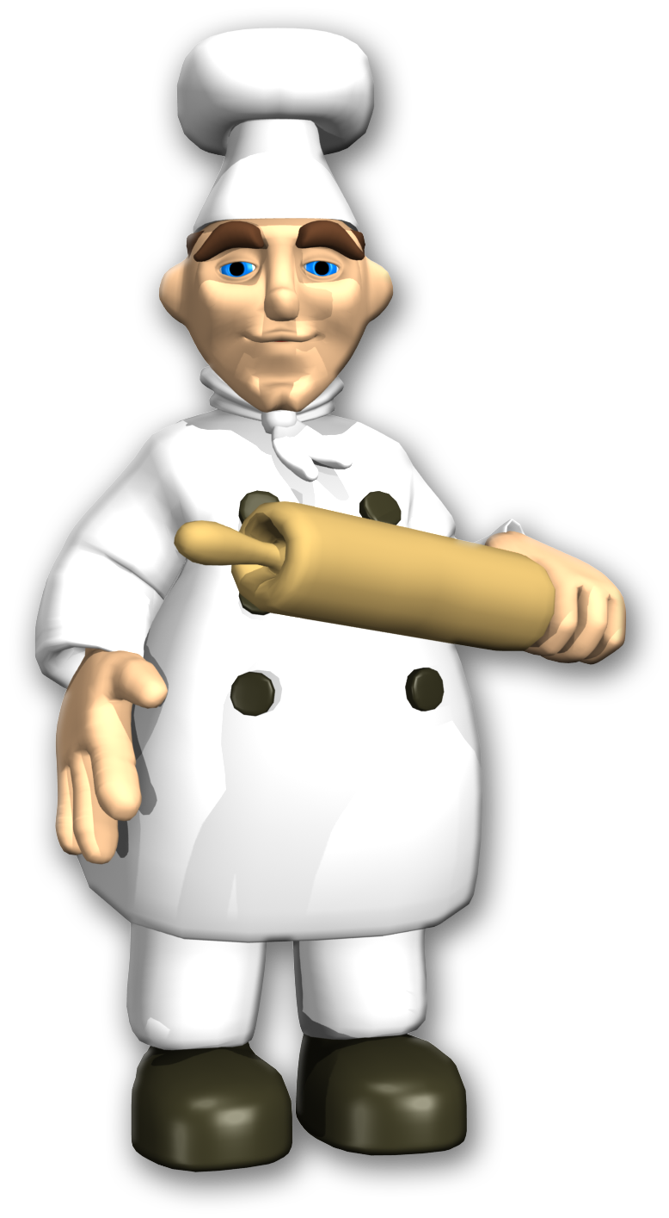
Test Taking Tips: A Recipe for Success!
By Teachers Unleashed

Slide 2
Greetings! I’m Chef Lemeril Spagasi, and I am what they call a Master Chef. Today, I’m here to teach you the importance of doing your best work during tests.
I’ve earned my title through many years of hard work, but I have to earn respect every day by proving to my customers that I’m an amazing chef.
You have that job too. Every day, you prove that you understand what you are being taught!

Slide 3
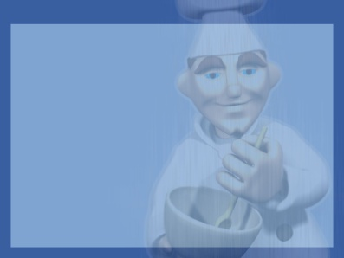
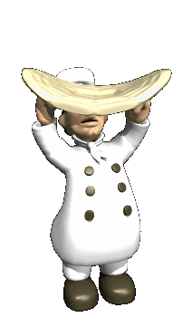
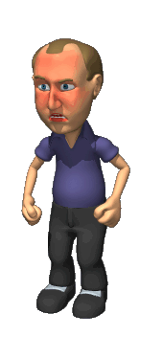
Let me give you an example… If I add too much garlic to my pizza sauce, my guests will look like this!
I HATE garlic! It’s stinky!

Slide 4
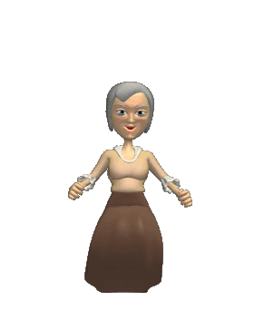
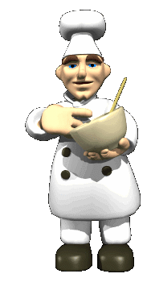
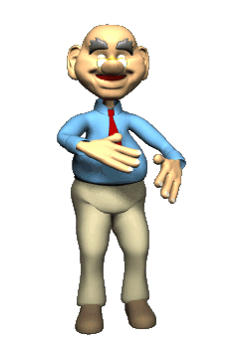
I want my customers to look like this instead.
That’s why I take my time with my cooking and always, ALWAYS check my work.
Mmmm, tasty!

Slide 5
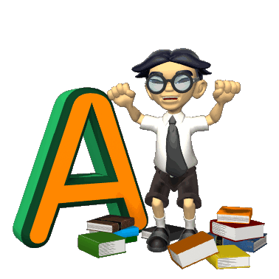
Let’s learn some tips, so that you can make that happen! Ready?
Here’s what you should look like when you’re done taking a test!

Slide 6
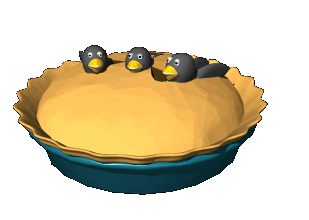
Here are some tips from master testers.
For writing, make sure you have written enough – and read your work back to yourself. You can catch mistakes you may have missed.
Show off your great vocabulary by adding or changing words to better choices.
TO HELP YOU USE 100% OF YOUR TIME DURING REVIEW TIME
For spelling, read your piece backwards, blocking out other lines with your fingers or another paper. This makes you look at each word by itself, and the mistakes POP out at you.

Slide 7
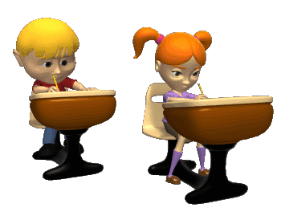
Do your own work.
It doesn’t help anyone to claim other peoples’ work as your own. Do YOUR best.

Slide 8
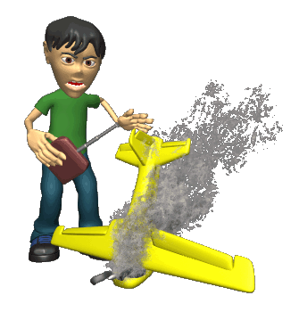
Read and understand the directions.
You can be sure to do your best when you really know what the question is asking you.
If you don’t understand, ask the teacher to explain. If they are allowed to explain the directions, they will.

Slide 9
Check off each line after you’ve read it.
Sometimes during tests, you can lose your place. Checking off each line helps you to remember where you are, if you get distracted.
Sally couldn’t believe her own eyes. When she walked downstairs Christmas morning, she couldn’t believe all of the presents.
Could all of these be for her?

Slide 10
Read all of the choices.
Cross off all of the answers that you know are wrong.
What happens first in the sequence of events?
Peter goes to a celebration, and sees the dragon.
B. Great Aunt gets her friends to help sew the dragon back together.
C. Peter gets a pair of dragon eyes from Dr. Fong.
D. Peter sees a dragon in a store in Chinatown.

Slide 11
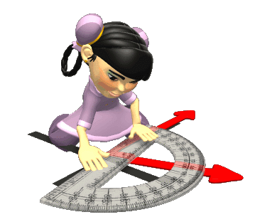
Show your work AND double check it!
It is so easy to make a silly mistake, and never notice it.
You want your knowledge to shine through. Don’t leave ANY blanks.
USE THAT LEFT OVER
REVIEW TIME WHEN
YOU ARE FINISHED!

Slide 12
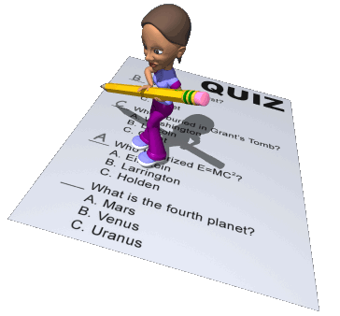
Don’t leave an answer blank.
If you’ve given the question your best shot, and you still don’t know, pick one answer, and go on.
Also – put a star beside it in case you have time at the
end to come back
and read again.

Slide 13
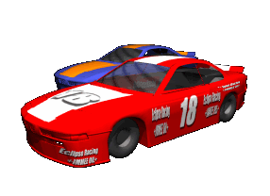
Leave the racing to the racecars!
It never makes sense to rush through a test to finish quickly. Taking your time means winning when it comes to grades.
IF YOU FIND YOU ONLY HAVE A COUPLE MINUTES LEFT…
THEN AND ONLY
THEN DO YOU
RUSH TO BUBBLE

Slide 14
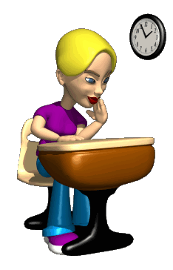
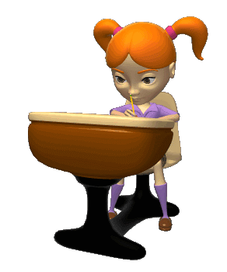
Don’t worry.
When everyone is done around you: take a deep breath, and get back to work.
Just because it may take a longer time for you to get an answer doesn’t mean you aren’t getting the right answer. You’re doing great!

Slide 15
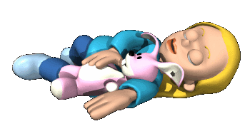
Get a good night’s rest!
Sleep helps your mind organize information, and allows your brain to function at top speed.

Slide 16
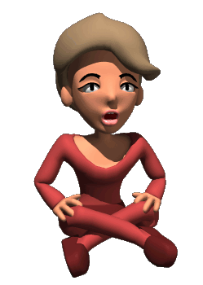
If nervous or distracted, remember to breathe.
A few deep breaths will help you to focus, and get back to business.

Slide 17
Skip hard questions if you get stuck. (If, and only if, your teacher says this is okay!)
Mark the questions that you skip, so that you won’t forget to come back to them later.

Slide 18
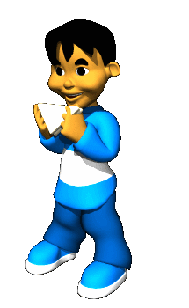
Eat well before the test.
Have a good breakfast. You want your body to be ready for those tough questions.

Slide 19
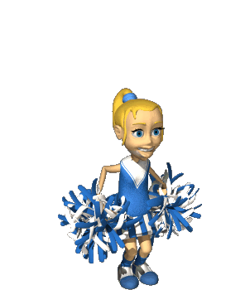
Get your positive attitude ready.
Be serious, but cool at the same time.
It is as important as your number 2 pencil! You’ve done the hard work of learning. Say “I can do this!” and get started.

Slide 20
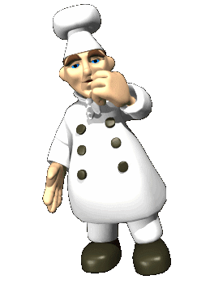
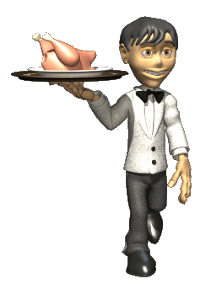
Remember to
“kick it up a notch!” You’ll be proud that you did.
“To Proficiency and Beyond!!!
“When we hit proficiency (68 or higher) then Mr. Rucker will shave a design into his hair!
“When we hit distinguished status as a school we will have high scoring student compete against teachers in ‘Minute to Win it’ competition!!

Slide 21
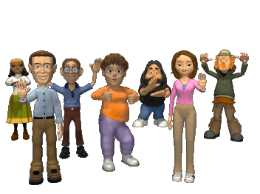
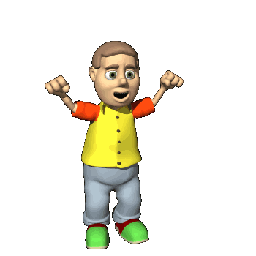
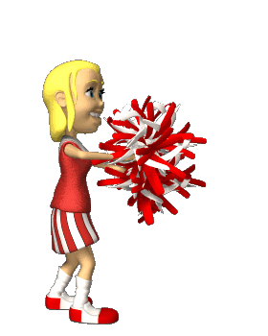
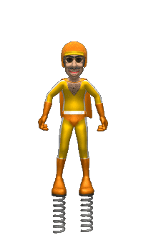
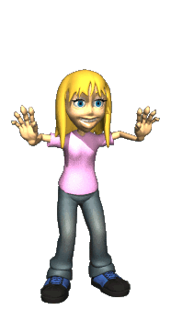
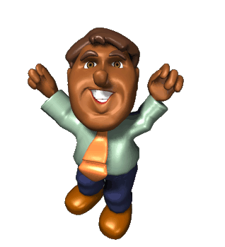
It’s almost time! Go out there, and show everyone that you’re a MASTER TESTER!

Slide 22
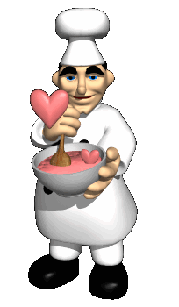
TEACHERS UNLEASHED
wishes you the
best of luck!
We know you can do it!
For more of our great products visit us at:
http://www.teacherspayteachers.com/Store/Teachers-Unleashed

